Slide 1
INTRODUCTION TO SOFTWARE ENGINEERING
LECTURE – 25
MAY 22, 2017

Slide 2
TOPICS COVERED
Distributed Software Engineering
Reuse Based Software Engineering
Configuration Management
CSD201 - Introduction to Software Engineering

Slide 3
Testing Conventional Applications
CSD201 - Introduction to Software Engineering

Slide 4
QUICK LOOK
Once source code has been generated, software must be tested to uncover as many errors as possible
During early stages of testing, a software engineer performs all tests
Reviews and other SQA (Software Quality Assurance) activities can do and uncover errors, but they are not sufficient
Software is tested from two different perspectives:
  Internal program logic is exercised using white-box test cases design techniques
  Software requirements are exercised using black-box test-case design techniques
CSD201 - Introduction to Software Engineering

Slide 5
QUICK LOOK
The work product
  A set of test cases designed to exercise internal logic, interfaces, component collaborations, and external requirements is designed and documented
  expected results are defined and actual results are recorded
Try hard to break the software
Design test cases in a disciplined fashion and review then for thoroughness
CSD201 - Introduction to Software Engineering

Slide 6
TESTING FUNDAMENTALS
The goal of testing is to find errors and a good test is one that has a high probability of finding an error
Therefore, you should design and implement a system or a product with “testability” in mind
Testability
  It is simply how easily a computer program can be tested
Operability
  The better it works, the more efficiently it can be tested
Observability
  What you see is what you test
CSD201 - Introduction to Software Engineering

Slide 7
TESTING FUNDAMENTALS
Controllability
  The better we can control the software, the more the testing can be automated and optimized
  All possible outputs can be generated through some combination of input
  Software and hardware states and variables can be controlled directly by the test engineer
CSD201 - Introduction to Software Engineering

Slide 8
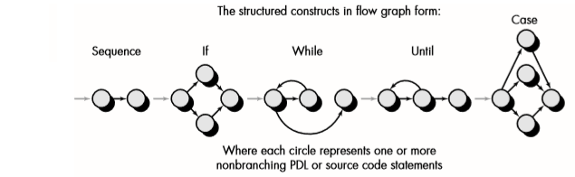
PATH TESTING
Flow Graph Notation
CSD201 - Introduction to Software Engineering

Slide 9
CYCLOMATIC COMPLEXITY
Cyclomatic complexity is a software metric that provides a quantitative measure of the logical complexity of a program
The value computed for cyclomatic complexity deﬁnes the number of independent paths in the basis set of a program
It provides us with an upper bound for the number of tests that must be conducted to ensure that all statements have been executed at least once
An independent path is any path through the program that introduces at least one new set of processing statements or a new condition
CSD201 - Introduction to Software Engineering

Slide 10
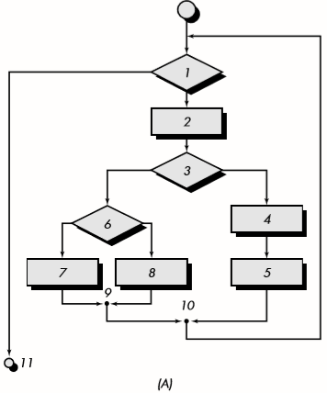
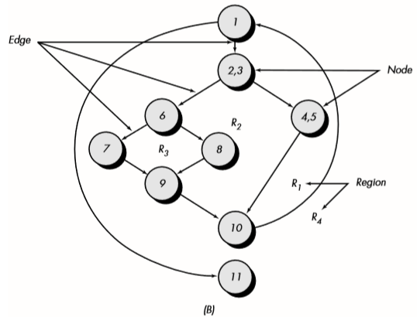
FLOW CHART AND FLOW GRAPH
CSD201 - Introduction to Software Engineering

Slide 11
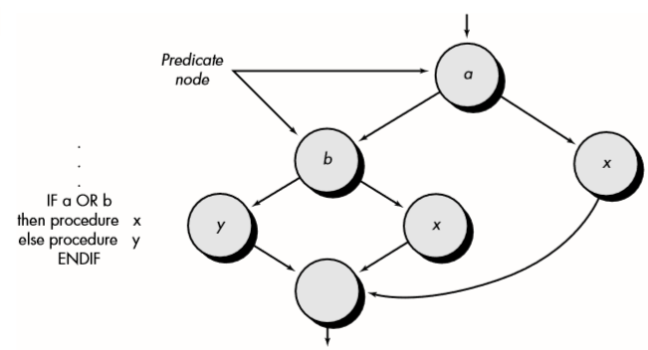
FLOW CHART AND FLOW GRAPH
Compound Logic
CSD201 - Introduction to Software Engineering

Slide 12
INDEPENDENT PROGRAM PATHS
It is any path through the program that introduces at least one new set of processing statements or a new condition
path 1: 1-11
path 2: 1-2-3-4-5-10-1-11
path 3: 1-2-3-6-8-9-10-1-11
path 4: 1-2-3-6-7-9-10-1-11
The number of regions of the ﬂow graph correspond to the cyclomatic complexity
Cyclomatic complexity, V(G), for a ﬂow graph, G, is deﬁned as V(G) = E - N + 2
where E is the number of ﬂow graph edges, N is the number of ﬂow graph nodes
CSD201 - Introduction to Software Engineering

Slide 13
INDEPENDENT PROGRAM PATHS
Cyclomatic complexity, V(G), for a ﬂow graph, G, is also deﬁned as
  V(G) = P + 1
  where P is the number of predicate nodes contained in the ﬂow graph G
The cyclomatic complexity can be computed using each of the algorithms just noted:
  The ﬂow graph has four regions
  V(G) = 11 edges - 9 nodes + 2 = 4
  V(G) = 3 predicate nodes + 1 = 4
The value for V(G) provides us with an upper bound for the number of independent paths that form the basis set
  an upper bound on the number of tests that must be designed and executed to guarantee coverage of all program statements
CSD201 - Introduction to Software Engineering

Slide 14
Distributed Software Engineering
CSD201 - Introduction to Software Engineering

Slide 15
DISTRIBUTED SYSTEMS ISSUES
Transparency
Openness
Scalability
Security
Quality of Service
Failure Management
CSD201 - Introduction to Software Engineering

Slide 16
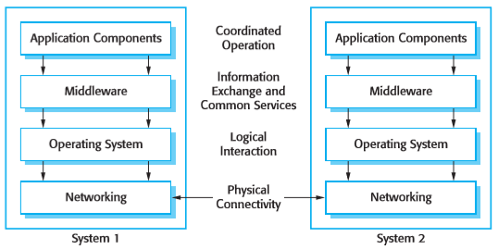
MIDDLEWARE
CSD201 - Introduction to Software Engineering

Slide 17

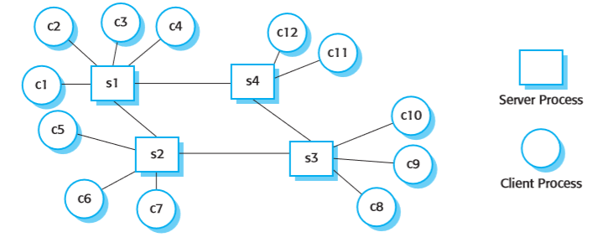
CLIENT-SERVER INTERACTION
CSD201 - Introduction to Software Engineering

Slide 18
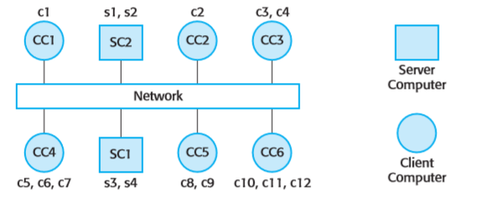
CLIENT-SERVER COMPUTING
CSD201 - Introduction to Software Engineering

Slide 19
REUSE-BASED SOFTWARE ENGINEERING
System reuse
  Complete systems, which may include several application programs may be reused.
Application reuse
  An application may be reused either by incorporating it without change into other or by developing application families.
Component reuse
  Components of an application from sub-systems to single objects may be reused.
Object and function reuse
  Small-scale software components that implement a single well-defined object or function may be reused.
CSD201 - Introduction to Software Engineering

Slide 20
THE RE-USE LANDSCAPE
Although reuse is often simply thought of as the reuse of system components, there are many different approaches to reuse that may be used
Reuse is possible at a range of levels from simple functions to complete application systems
The reuse landscape covers the range of possible reuse techniques
CSD201 - Introduction to Software Engineering

Slide 21
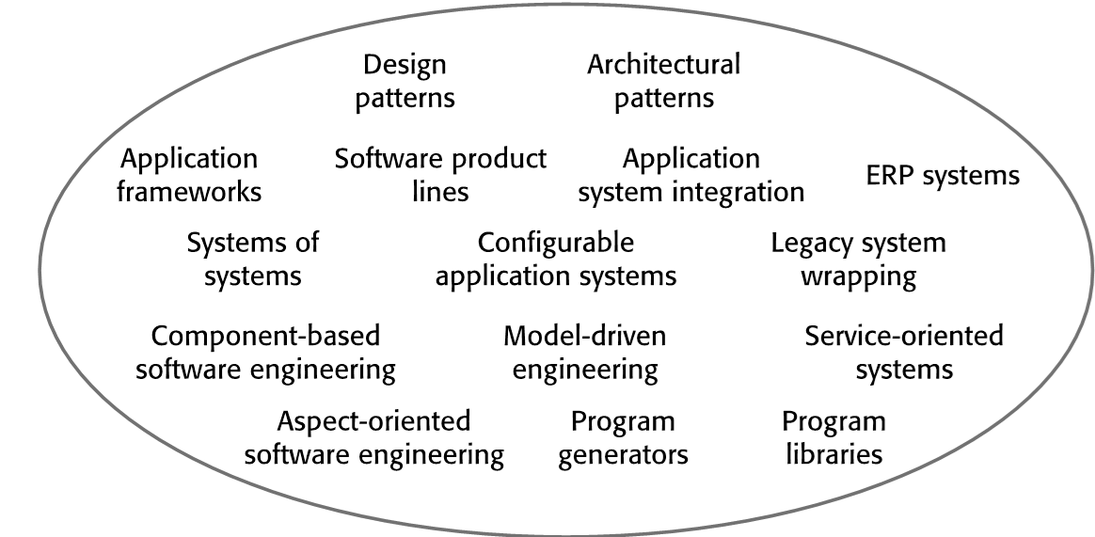
THE RE-USE LANDSCAPE
CSD201 - Introduction to Software Engineering

Slide 22
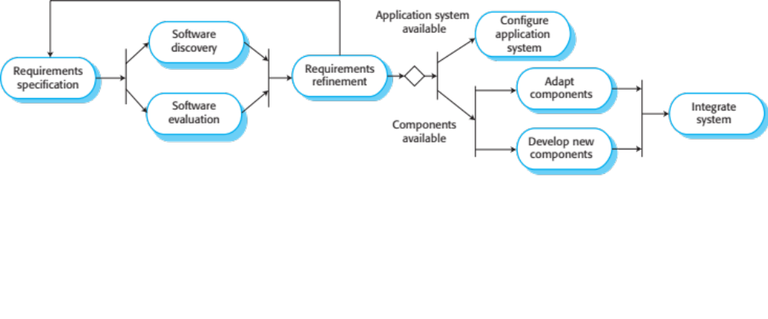
REUSE-ORIENTED SOFTWARE ENGINEERING
CSD201 - Introduction to Software Engineering

Slide 23
KEY PROCESS STAGES FOR ACQUISITION
Requirements specification
Software discovery and evaluation
Requirements refinement
Application system configuration
Component adaptation and integration
CSD201 - Introduction to Software Engineering

Slide 24
DOMAIN ENGINEERING FOR REUSE IN SE
Domain Engineering entails:
Domain Analysis
  Commonalities and differences of systems in a domain are discovered and recorded
Domain Implementation
  It means the use of information collected in domain analysis to create reusable components and new systems
CSD201 - Introduction to Software Engineering

Slide 25
CHARACTERISTICS OF GOOD DESIGN
Component independence
  High cohesion
  Low coupling
Exception identification and handling
Fault prevention and fault tolerance
Design for change
M1
M2
M3
CSD201 - Introduction to Software Engineering

Slide 26
COHESION
Definition
  The degree to which all elements of a component are directed towards a single task
  The degree to which all elements directed towards a task are contained in a single component
  The degree to which all responsibilities of a single class are related
Internal glue with which component is constructed
All elements of component are directed toward and essential for performing the same task
CSD201 - Introduction to Software Engineering

Slide 27
COUPLING
The degree of dependence such as the amount of interactions among components
No dependencies
Loosely coupled
some dependencies
Highly coupled
many dependencies
CSD201 - Introduction to Software Engineering

Slide 28
CONFIGURATION MANAGEMENT (CM)
Software systems are constantly changing during development and use
Configuration management (CM) is concerned with the policies, processes and tools for managing changing software systems
You need CM because it is easy to lose track of what changes and component versions have been incorporated into each system version
CM is essential for team projects to control changes made by different developers
CSD201 - Introduction to Software Engineering

Slide 29
CM ACTIVITIES
Version management
  Keeping track of the multiple versions of system components and ensuring that changes made to components by different developers do not interfere with each other
System building
  The process of assembling program components, data and libraries, then compiling these to create an executable system
Change management
  Keeping track of requests for changes to the software from customers and developers, working out the costs and impact of changes, and deciding the changes should be implemented
Release management
  Preparing software for external release and keeping track of the system versions that have been released for customer use
CSD201 - Introduction to Software Engineering

Slide 30
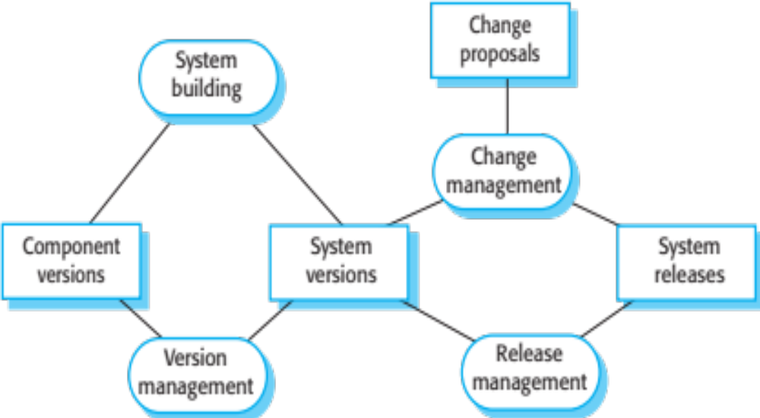
CM ACTIVITIES
CSD201 - Introduction to Software Engineering

Slide 31
AGILE DEVELOPMENT AND CM
Agile development, where components and systems are changed several times per day, is impossible without using CM tools
The definitive versions of components are held in a shared project repository and developers copy these into their own workspace
They make changes to the code then use system building tools to create a new system on their own computer for testing
  Once they are happy with the changes made, they return the modified components to the project repository
CSD201 - Introduction to Software Engineering

Slide 32
Q&A
CSD201 - Introduction to Software Engineering

